Slide 1
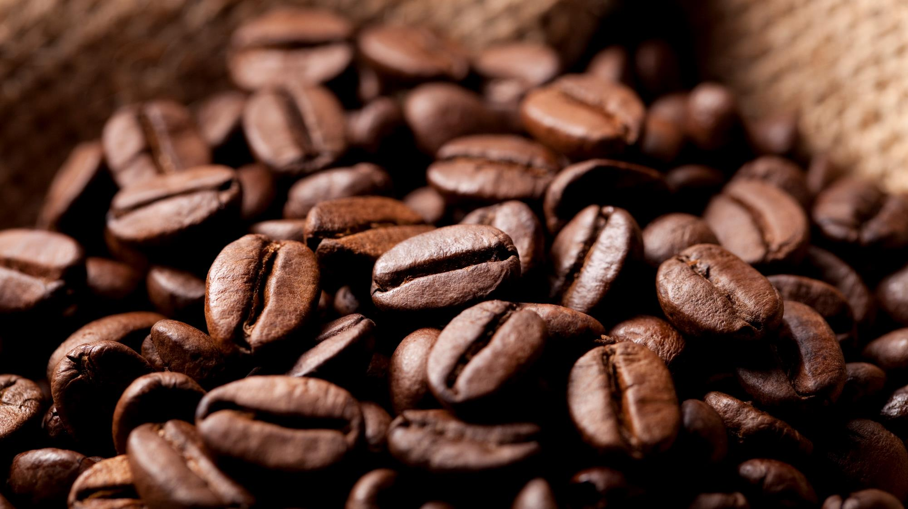
BRIGHT COFFEE SHOP
Business Performance
And Insights
Presented by Mojalefa Molatlhegi

Slide 2
objective
Which product s generate the most revenue?
What time of day the store performs best?
Sales trends across products and time intervals.
Recommendations for improving sales performance.

Slide 3

Which products generate the most revenue?

Slide 4
What time of day the store performs best?
Based on our data, all 3 stores perform best in the morning but our Lower Manhattan branch is the one at the top followed by Hell’s Kitchen then Astoria.

Slide 5
Sales trends across products and time intervals

Slide 6
Recommendations for improving sales performance.
Sales Performance Improvement
Optimize peak hours: Increase staffing and efficiency during busy times
Promote top products: Focus on best-sellers and use bundles to boost revenue
Improve slow periods: Run discounts and promotions during low-demand times
Support weak stores: Apply targeted strategies to underperforming locations
Align inventory: Stock high-demand items and reduce low-performing ones
Use data continuously: Monitor trends to make informed decisions
Upsell & cross-sell: Encourage add-ons to increase transaction value
Localize strategies: Tailor offerings based on each store’s performance

Slide 7
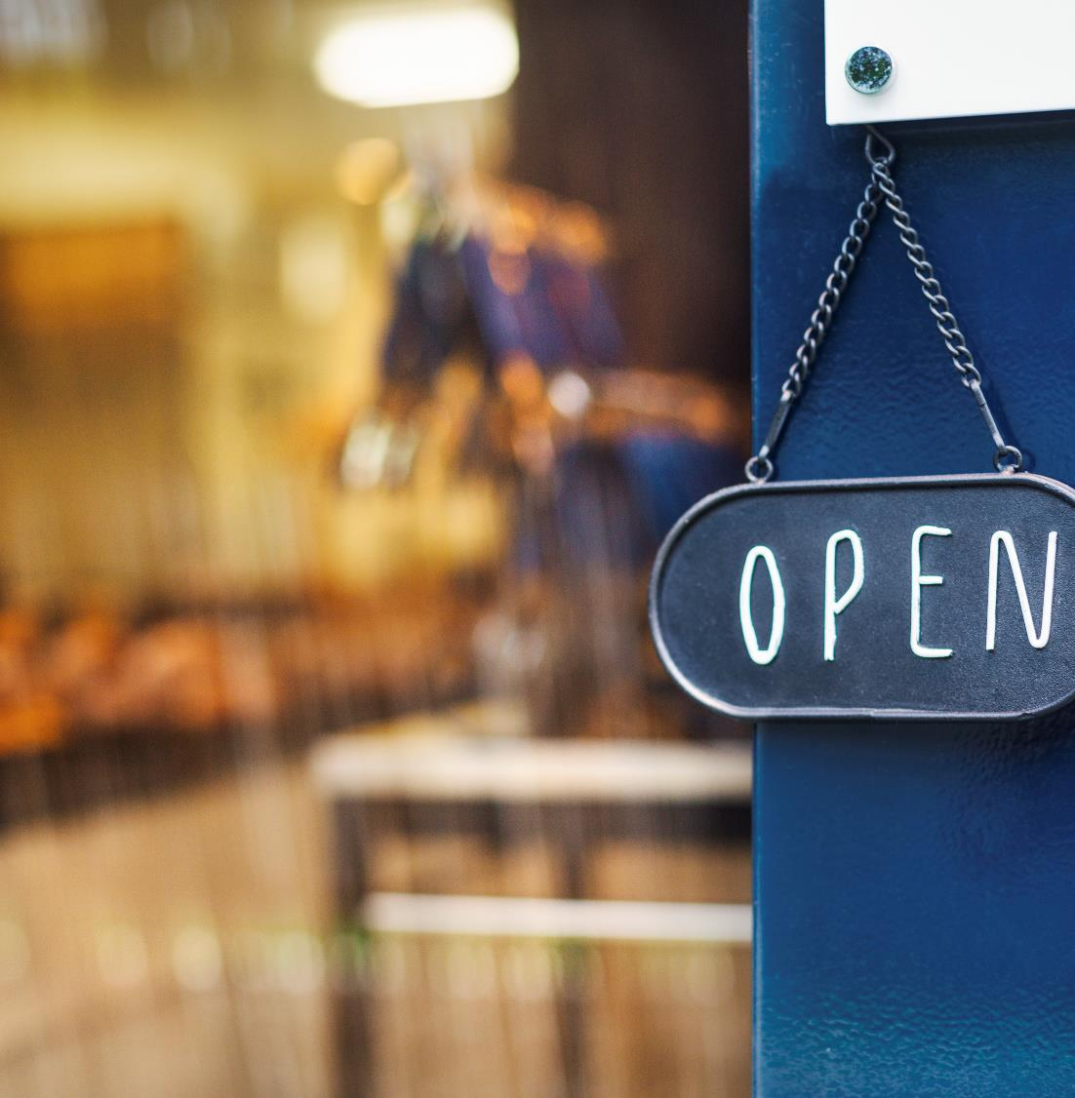

Thank You
Email mmolatlhegi73@gmail.com

